Slide 1

CSC 2302/DSCI 1302 Object Oriented Programming (cont.)
- S M Towhidul Islam

Slide 2

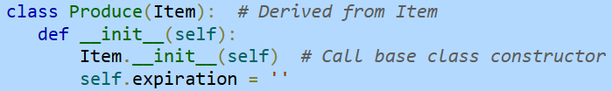


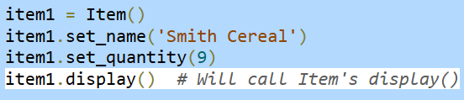
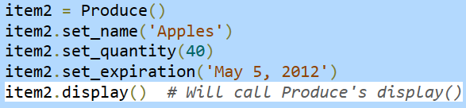
Overriding class methods
A member function of base class can redefine the method of the base class

Slide 3
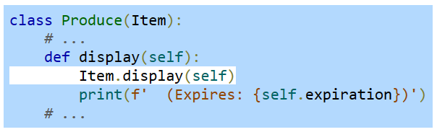
Overriding class methods
If needed, the derived class method can call the base class method

Slide 4
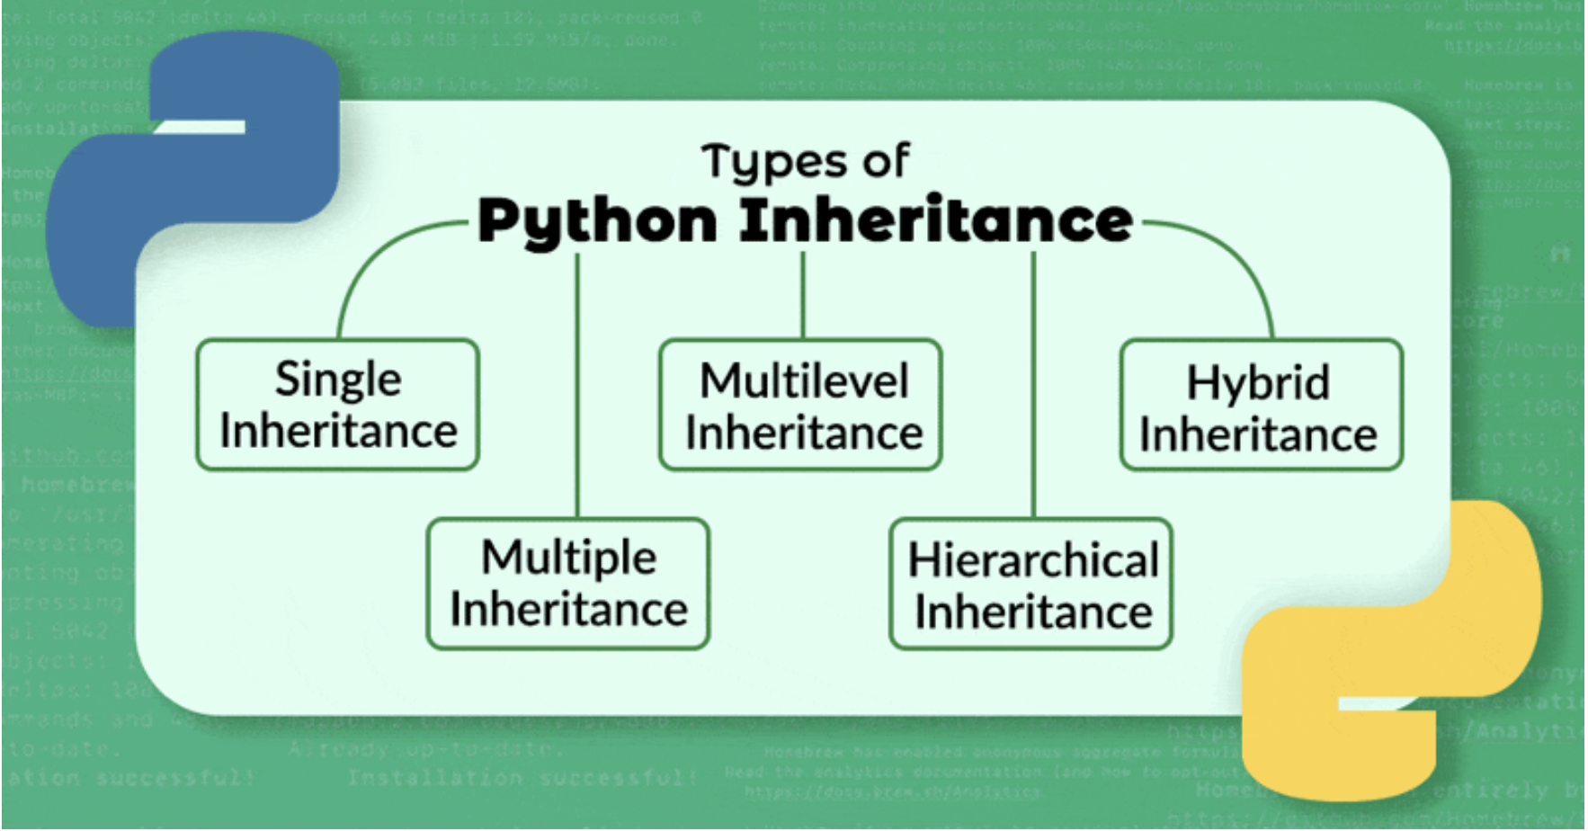

Slide 5
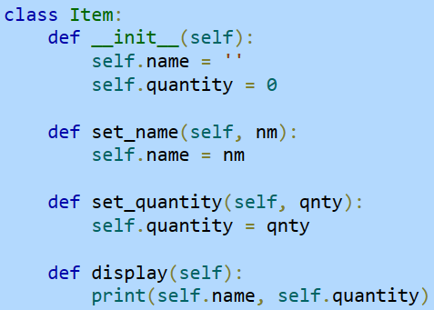
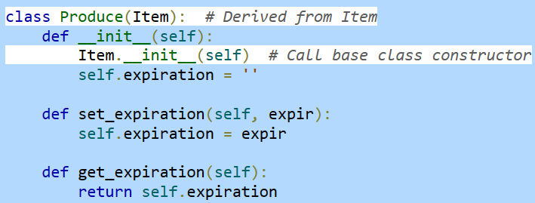
Single
Inheritance

Slide 6
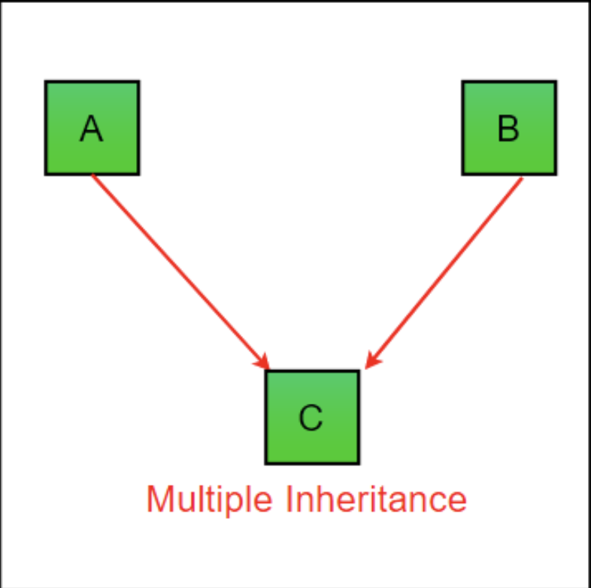
Multiple Inheritance
A class can be derived from more than one superclass in Python.
class SuperClass1: # features of SuperClass1 class SuperClass2: # features of SuperClass2 class MultiDerived(SuperClass1, SuperClass2): # features of SuperClass1 + SuperClass2 + MultiDerived class

Slide 7
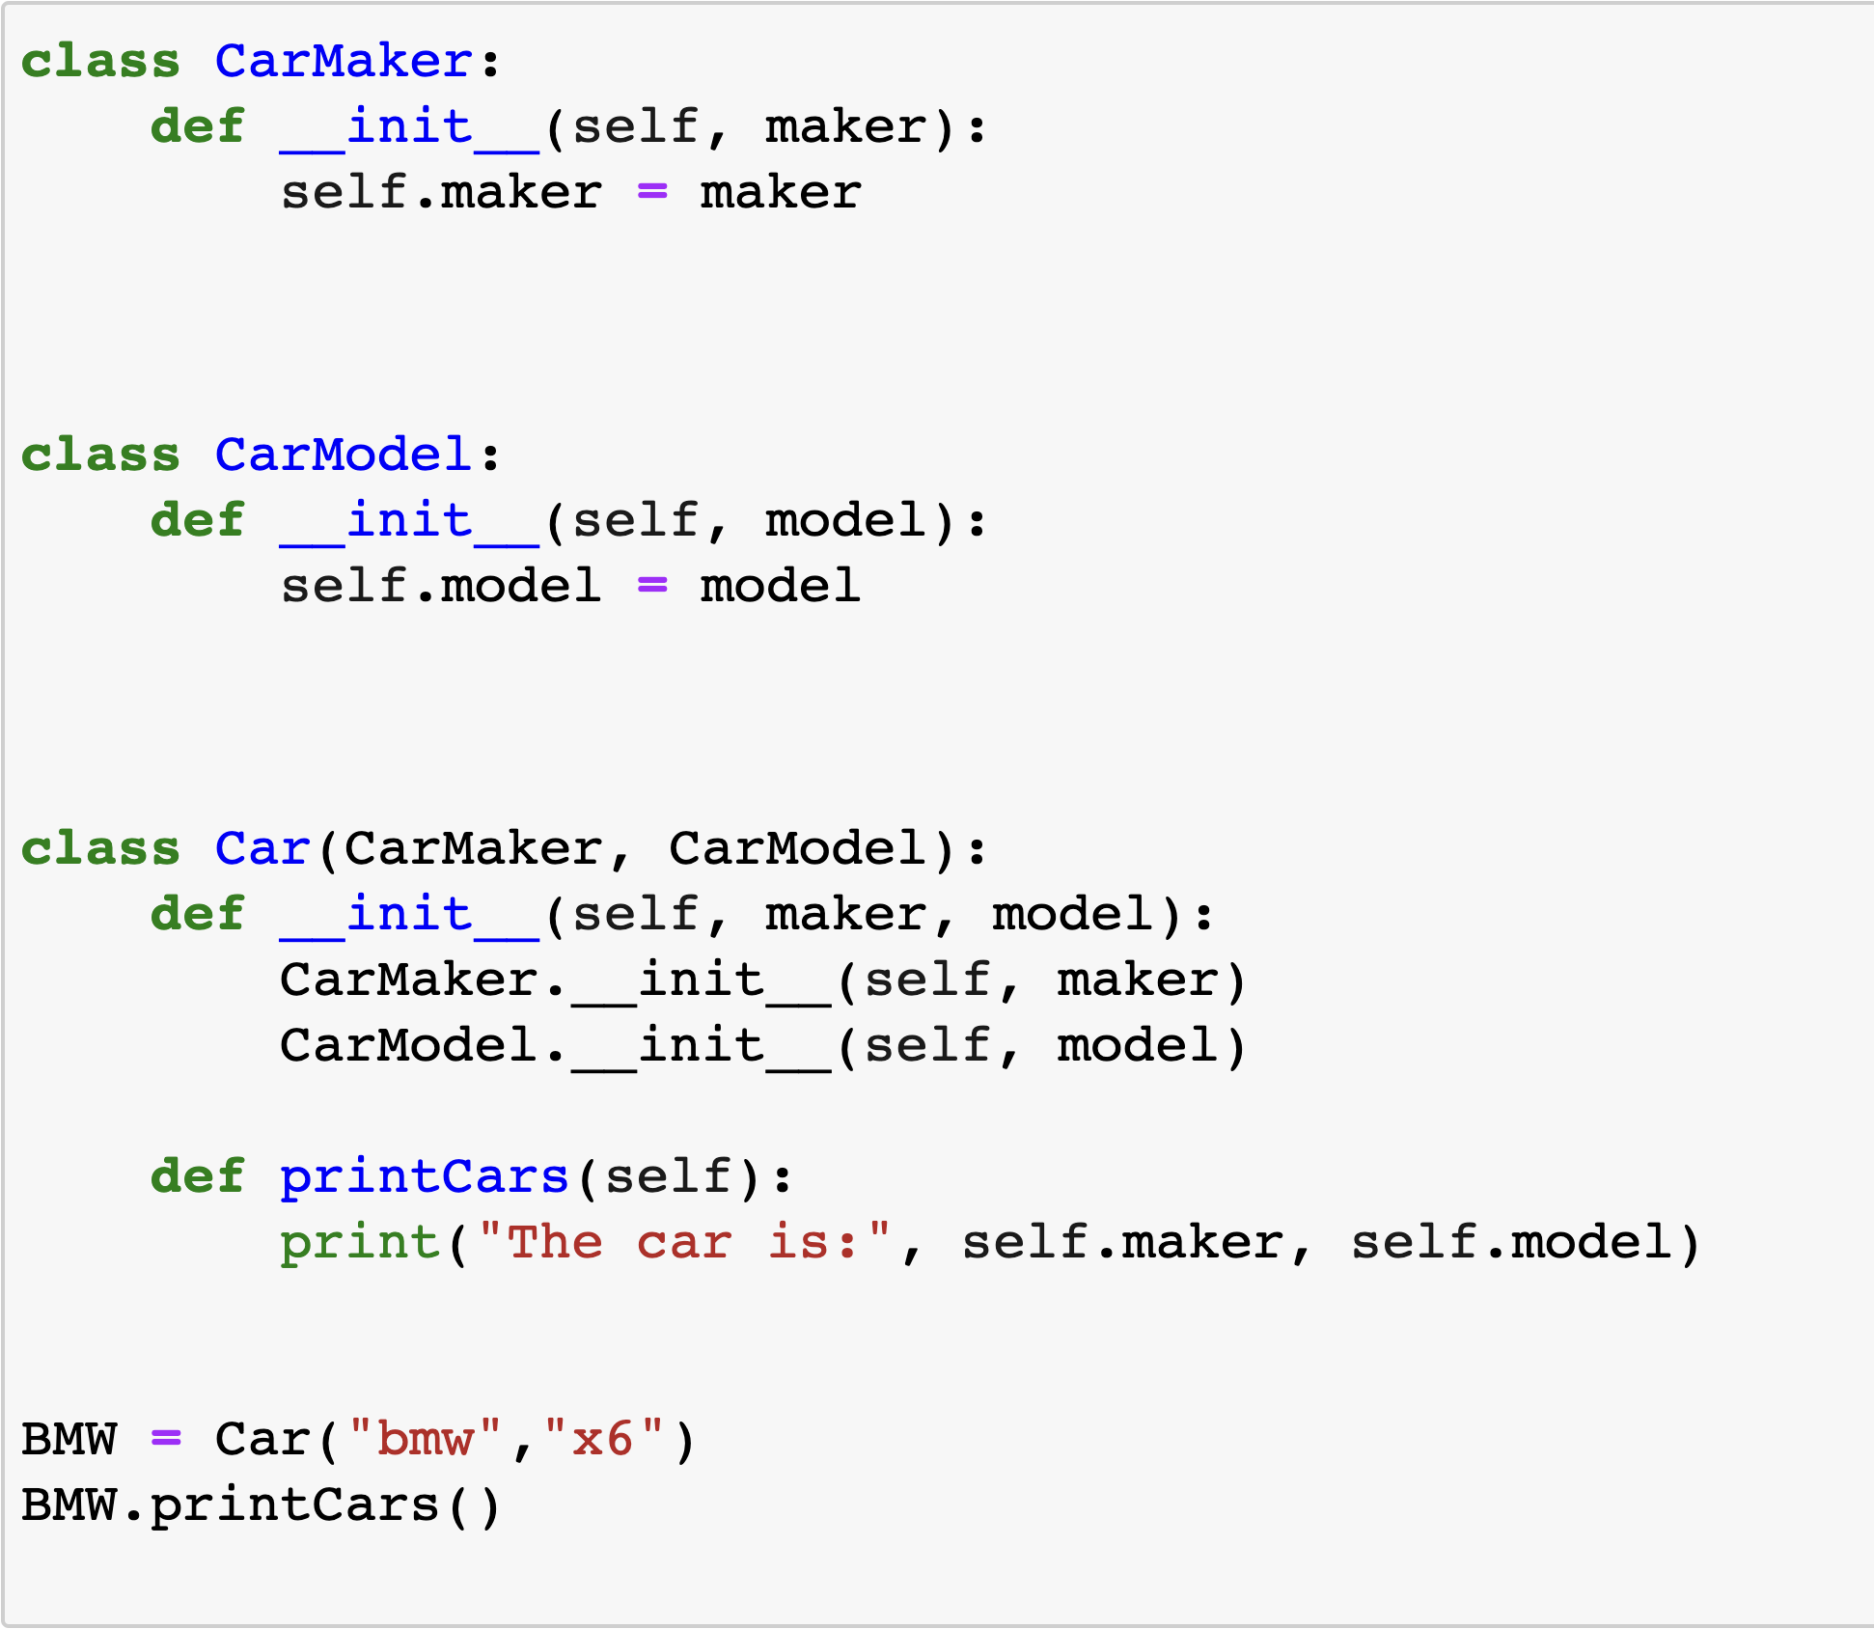

Slide 8
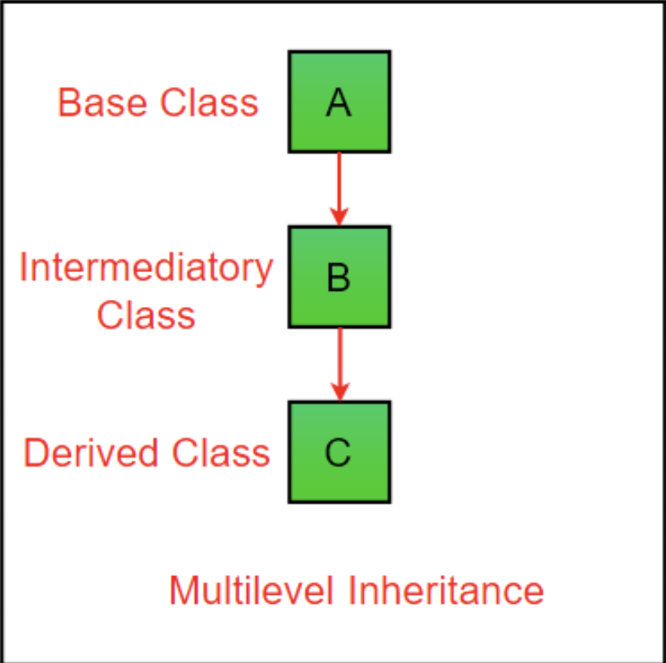
MultiLevel Inheritance
In Python, not only can we derive a class from the superclass but you can also derive a class from the derived class.
This form of inheritance is known as multilevel inheritance.
class SuperClass: # Super class code here class DerivedClass1(SuperClass): # Derived class 1 code here class DerivedClass2(DerivedClass1): # Derived class 2 code here
Notes:
Here, the DerivedClass1 class is derived from the SuperClass class, and the DerivedClass2 class is derived from the DerivedClass1 class.

Slide 9
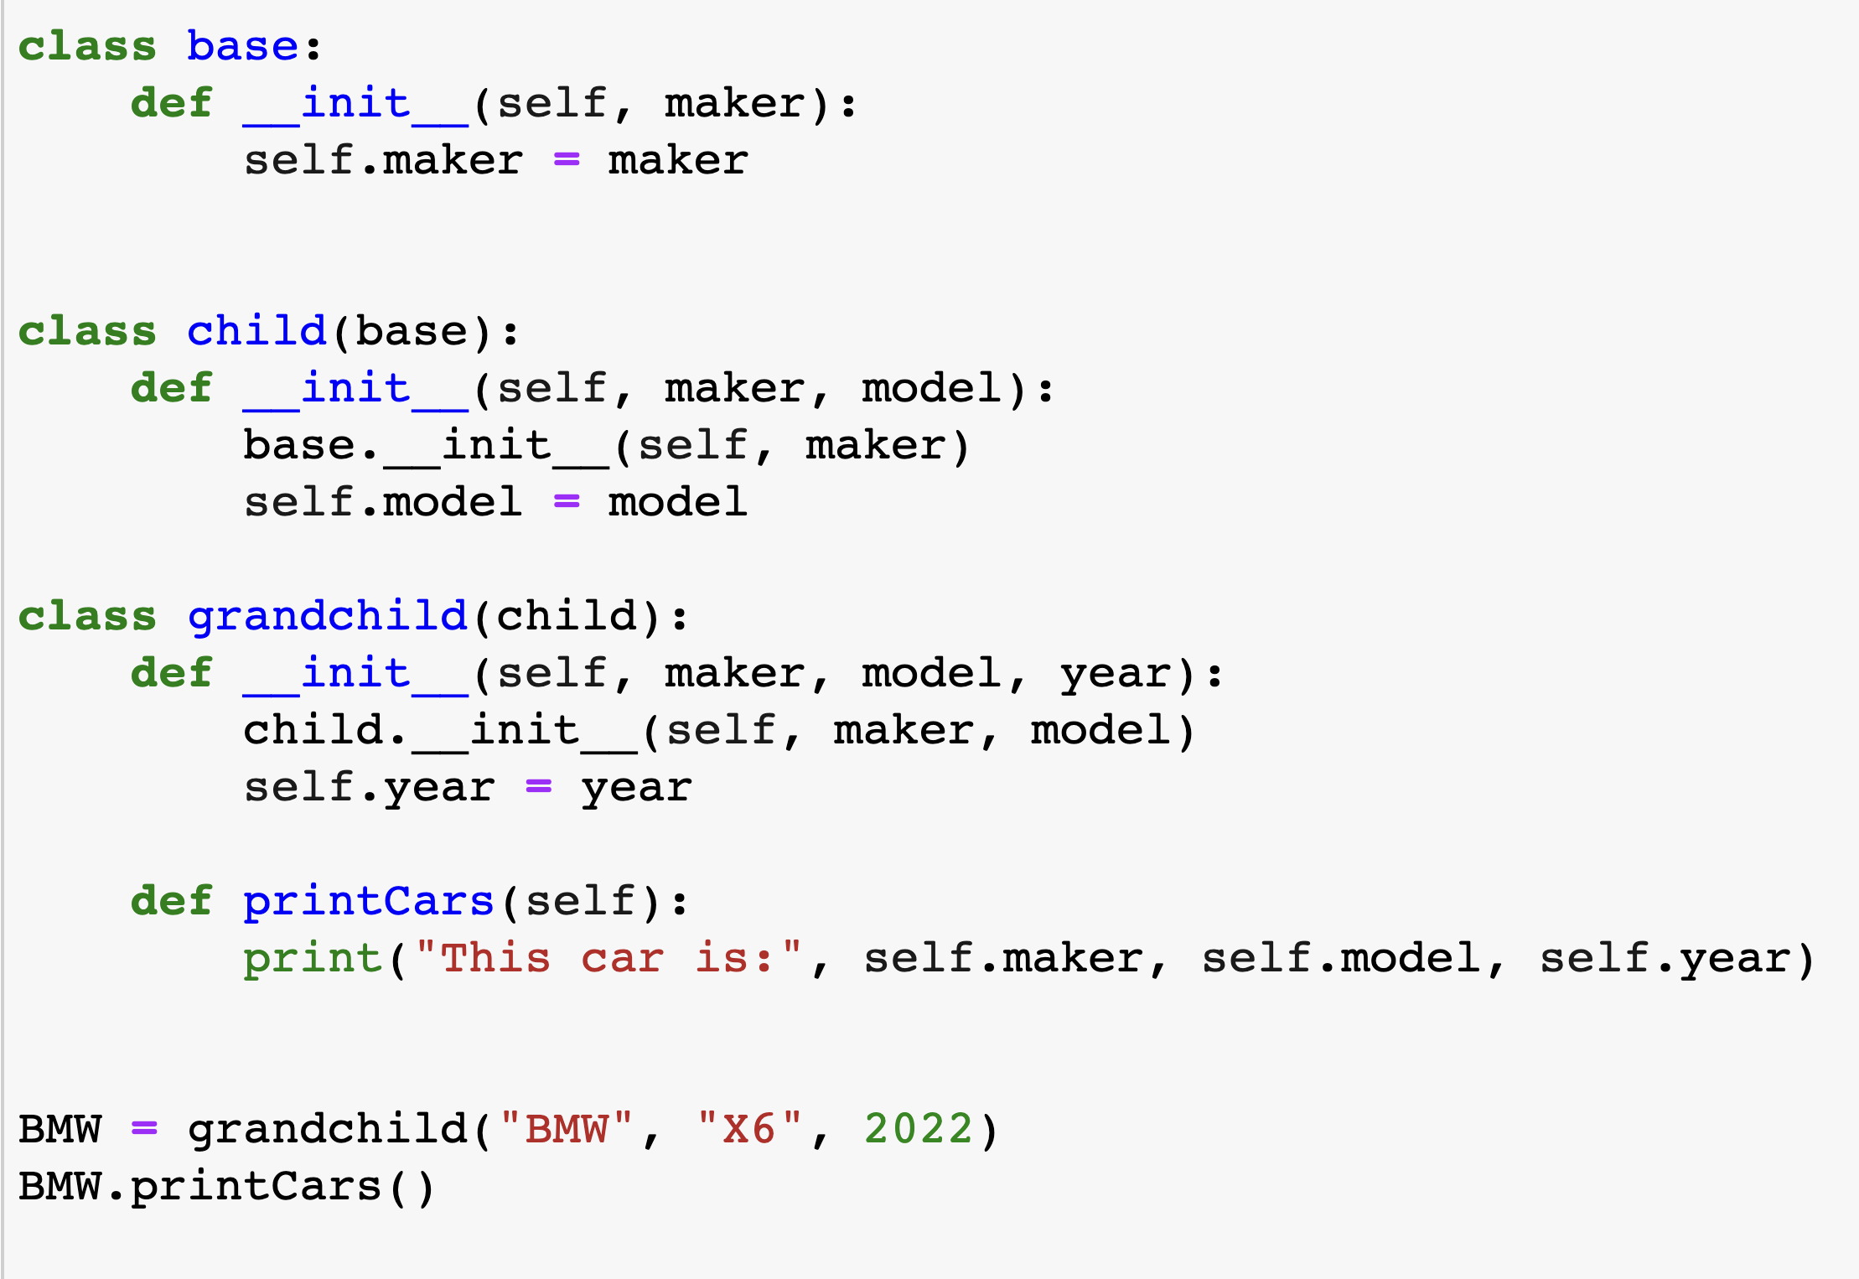

Slide 10
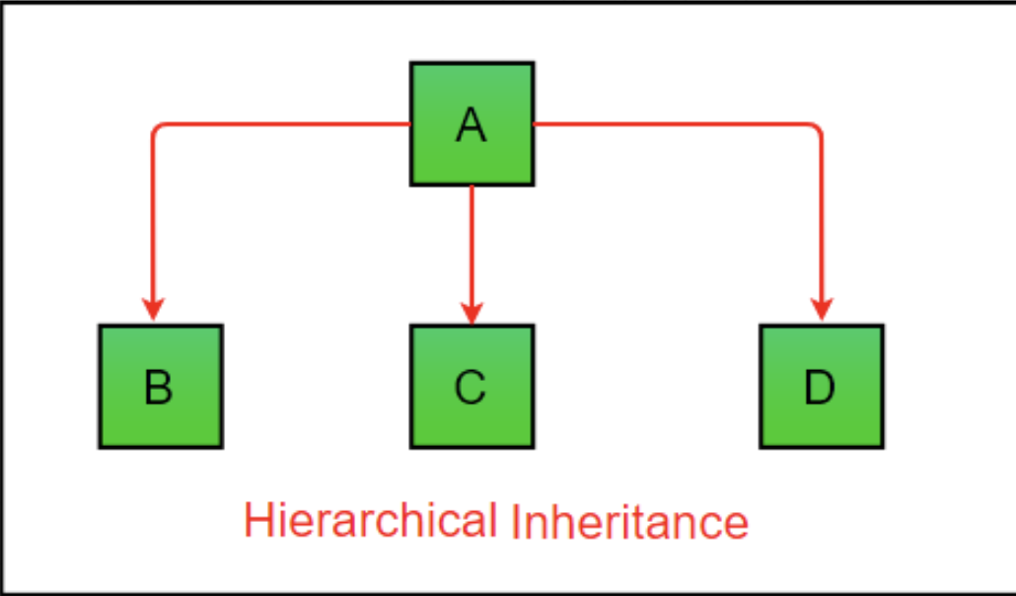
Hierarchical Inheritance
When more than one derived class are created from a single base, this type of inheritance is called hierarchical inheritance.
Hybrid Inheritance
Multiple types of inheritances
Notes:
we have a parent (base) class and two child (derived) classes.

Slide 11
Method Resolution Order (MRO) in Python
Hybrid Inheritance
A
Hierarchical Inheritance
print()
B
C
print()
Multiple Inheritance
D
d = D()
d.print()
Which version of the print() method will be called?
Diamond Problem!

Slide 12
Method Resolution Order (MRO)
If two super classes have the same method name and the derived class calls that method, Python uses the MRO to search for the right method to call.
class SuperClass1: def info(self): print("Super Class 1 method called") class SuperClass2: def info(self): print("Super Class 2 method called") class Derived(SuperClass1, SuperClass2): pass d1 = Derived() d1.info() # Output: "Super Class 1 method called"

Slide 13
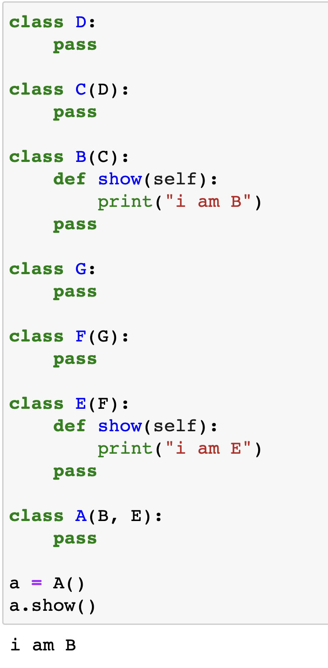
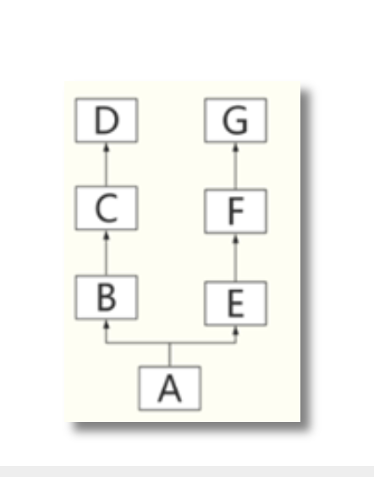

Slide 14
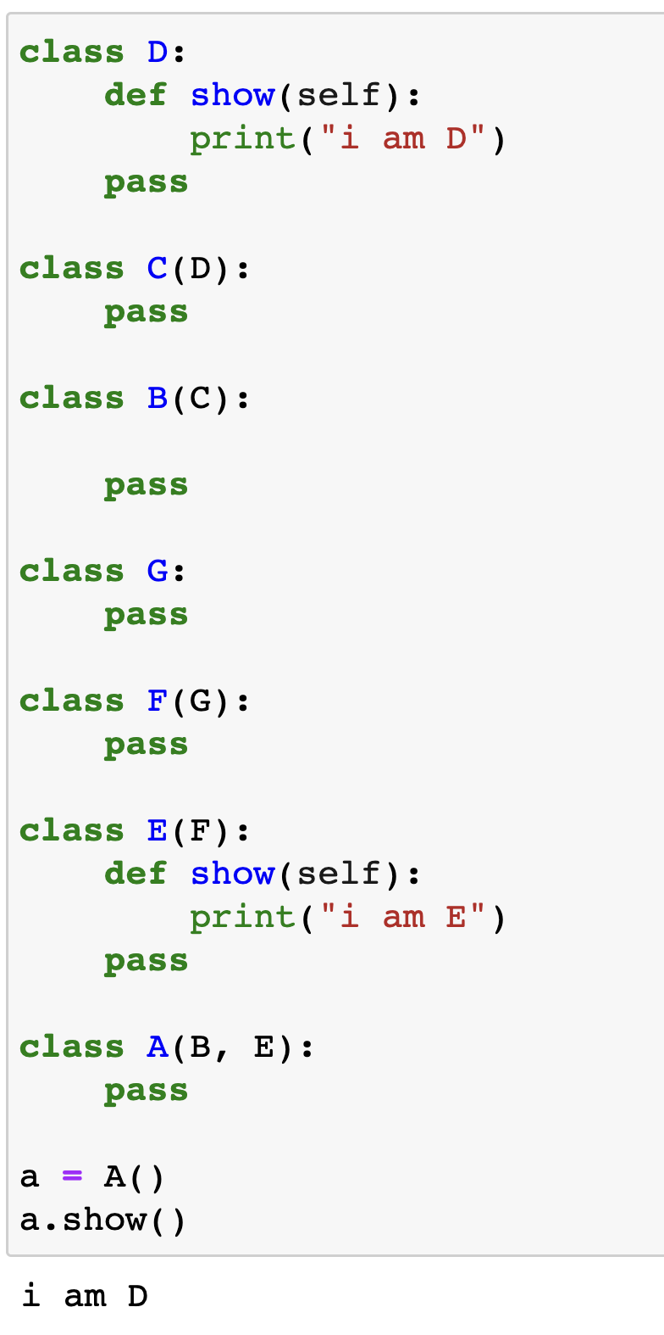
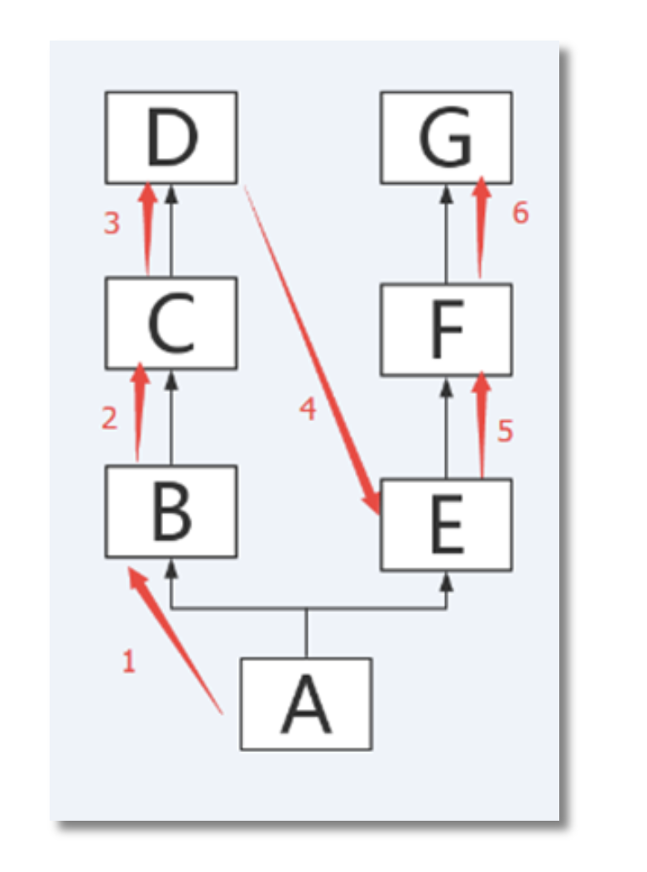

Slide 15
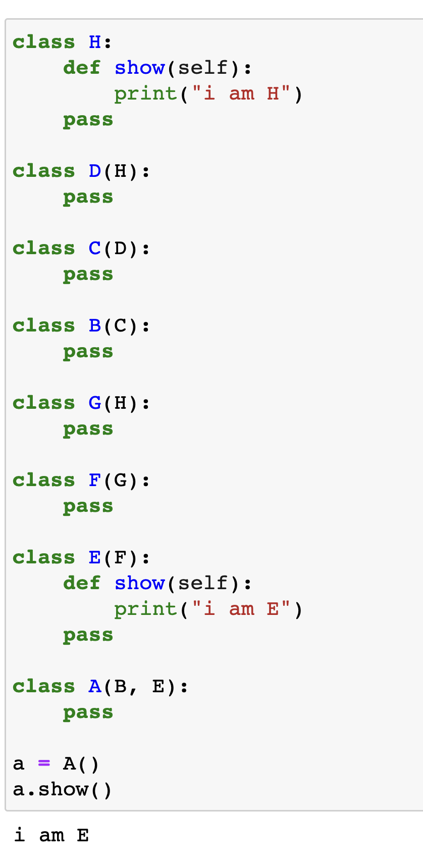
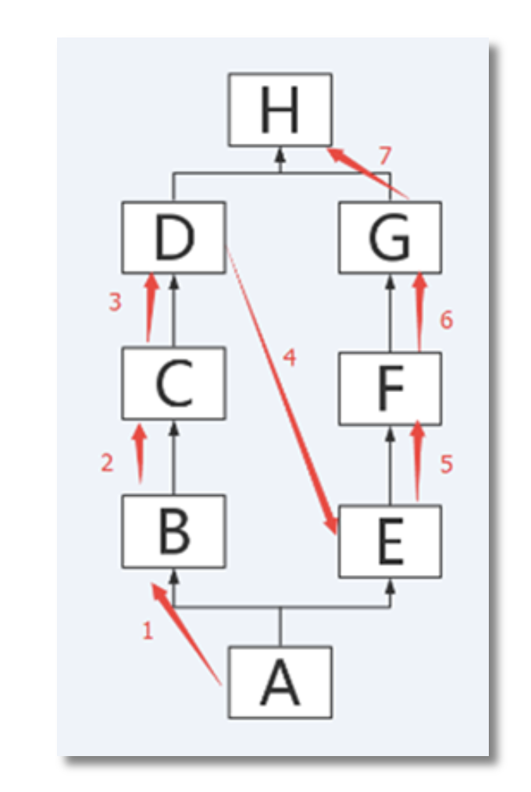

Slide 16
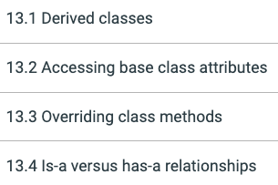
Suggested Reading (ZyBook)

Slide 17
Object composition
Object Composition is a fundamental concept in OOP
It helps to build complex and flexible systems by combining smaller, self-contained objects
Composition is the idea that one object may be made up of other objects
Thus, a larger system can be created by assembling smaller, reusable components
Promotes code reuse, modularity, and maintainability

Slide 18
Object composition
Car
Classroom
Engine
Transmission
Wheel
Chair
Table
Screen
When an object is created of other objects, the relationship is called ‘Has-a’ relationship
For example,
Car > Has-a > engine
Classroom > Has-a > number of chairs

Slide 19
Object Composition - Demonstration
Car
Engine
Transmission
Wheel
v4/v6
Automatic/manual
Rim Size

Slide 20
class Car: make = 'Toyota' def __init__(self, engine, transmission, wheel): self.engine = engine self.transmission = transmission self.wheel = wheel def print_info(self): print(f'Cylinders: {self.engine.num_cylinders} Transmission: {self.transmission.type} RimSize: {self.wheel.rim_size}') class Engine: def __init__(self, num_cylinders): self.num_cylinders = num_cylinders class Transmission: def __init__(self, type): self.type = type class Wheel: def __init__(self, rim_size): self.rim_size = rim_size

Slide 21
(cont.)
#create the smaller objects/components v4_engine = Engine(4) v6_engine = Engine(6) auto_transmission = Transmission('automatic') manual_transmission = Transmission('manual') small_wheel = Wheel(17) large_wheel = Wheel(19) #compose different types of car objects car1 = Car(v4_engine, auto_transmission, small_wheel) car2 = Car(v6_engine, auto_transmission, large_wheel) car3 = Car(v4_engine, manual_transmission, small_wheel) car1.print_info() car2.print_info() car3.print_info()

Slide 22
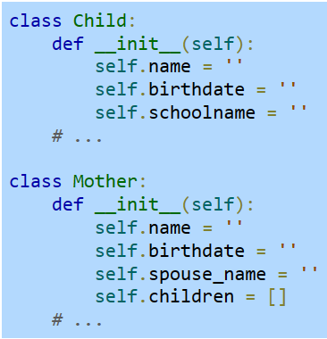
Is-a vs Has-a relationship
The concept of inheritance is often confused with composition
Composition is the idea that one object may be made up of other objects
Mother class : Has-a relationship with child class
Doesn’t involve inheritance

Slide 23
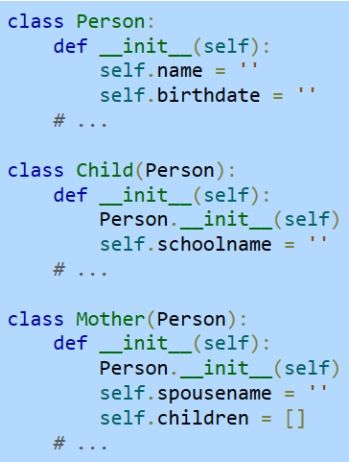
Is-a vs Has-a relationship
A programmer may note that a mother and a child are both a kind of person
So, the programmer may decide to better organize the program by defining a Person class
The Child and Mother classes have “is-a” relationship with Person class

Slide 24
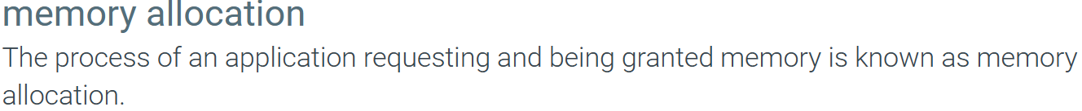
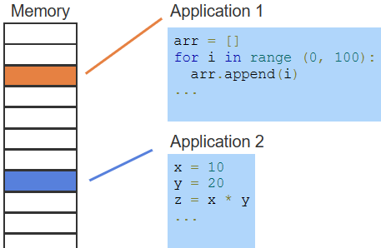
Memory allocation
System memory is partitioned into segments and managed by the operating system.
If a Python application creates an array with 100 items, the Python runtime has allocated space for this array.
Other applications may use other areas of allocated memory.
Memory allocation is usually invisible to the programmer, since the allocation is done by the Python runtime.

Slide 25
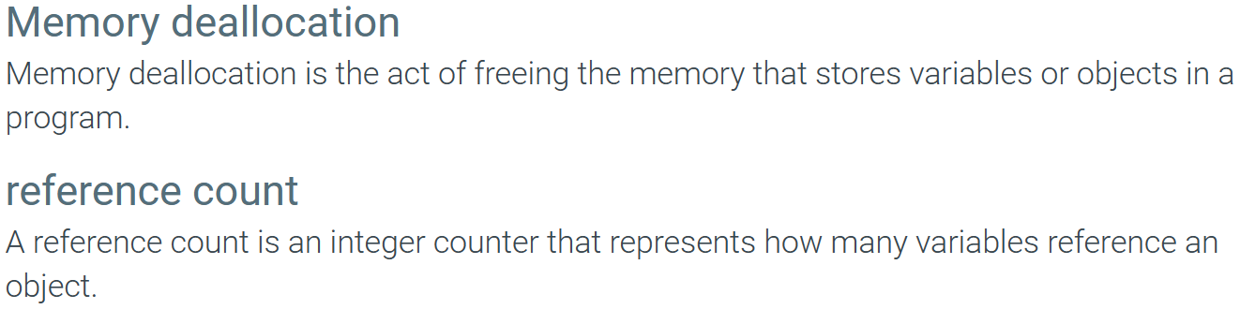
Memory deallocation / Garbage Collection

Slide 26
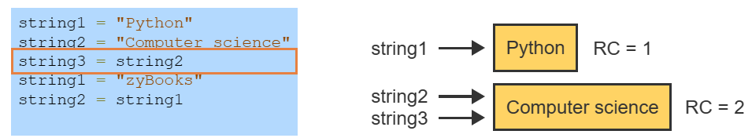
Memory deallocation / Garbage Collection
Reference count

Slide 27
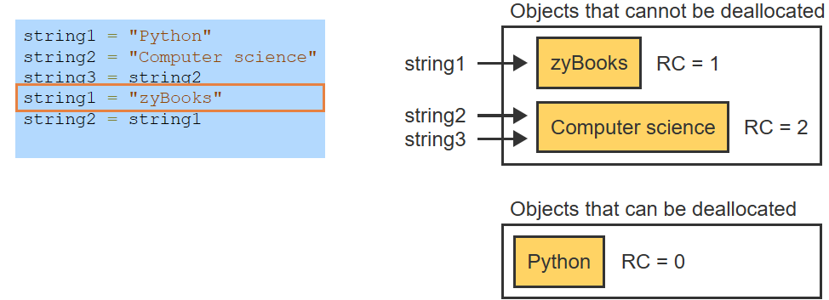

Slide 28
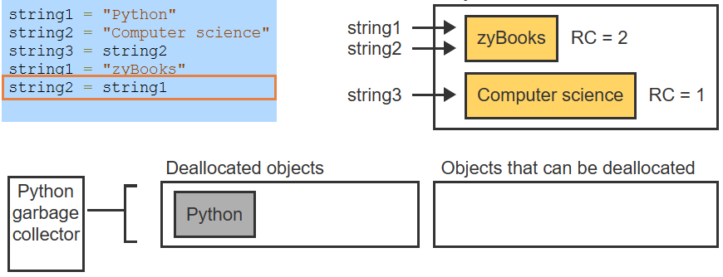
Memory deallocation / Garbage Collection
The Python garbage collector will eventually deallocate objects that are no longer referenced.

Slide 29
Exercises – ZyBook 9.10.2, 9.10.4

Slide 30
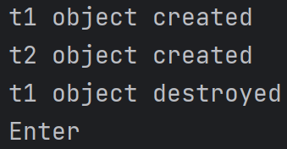
Memory deallocation / Garbage Collection
class Time: def __init__(self, name): self.name = name print('{} object created'.format(self.name)) def __del__(self): print('{} object destroyed'.format(self.name)) a = Time('t1’) a = Time('t2') input = input('Enter')
def __del__(self):
// on object destroyed
a
t1
t2
Program not terminated yet!

Slide 31
Suggested Reading (ZyBook):
9.10 Memory allocation and garbage collection

